Slide 1
Today
Quiz
Respiratory system part 1

Slide 2
Organs of the Respiratory System
Nose
Pharynx
Larynx
Trachea
Bronchi
Lungs—alveoli

Slide 3
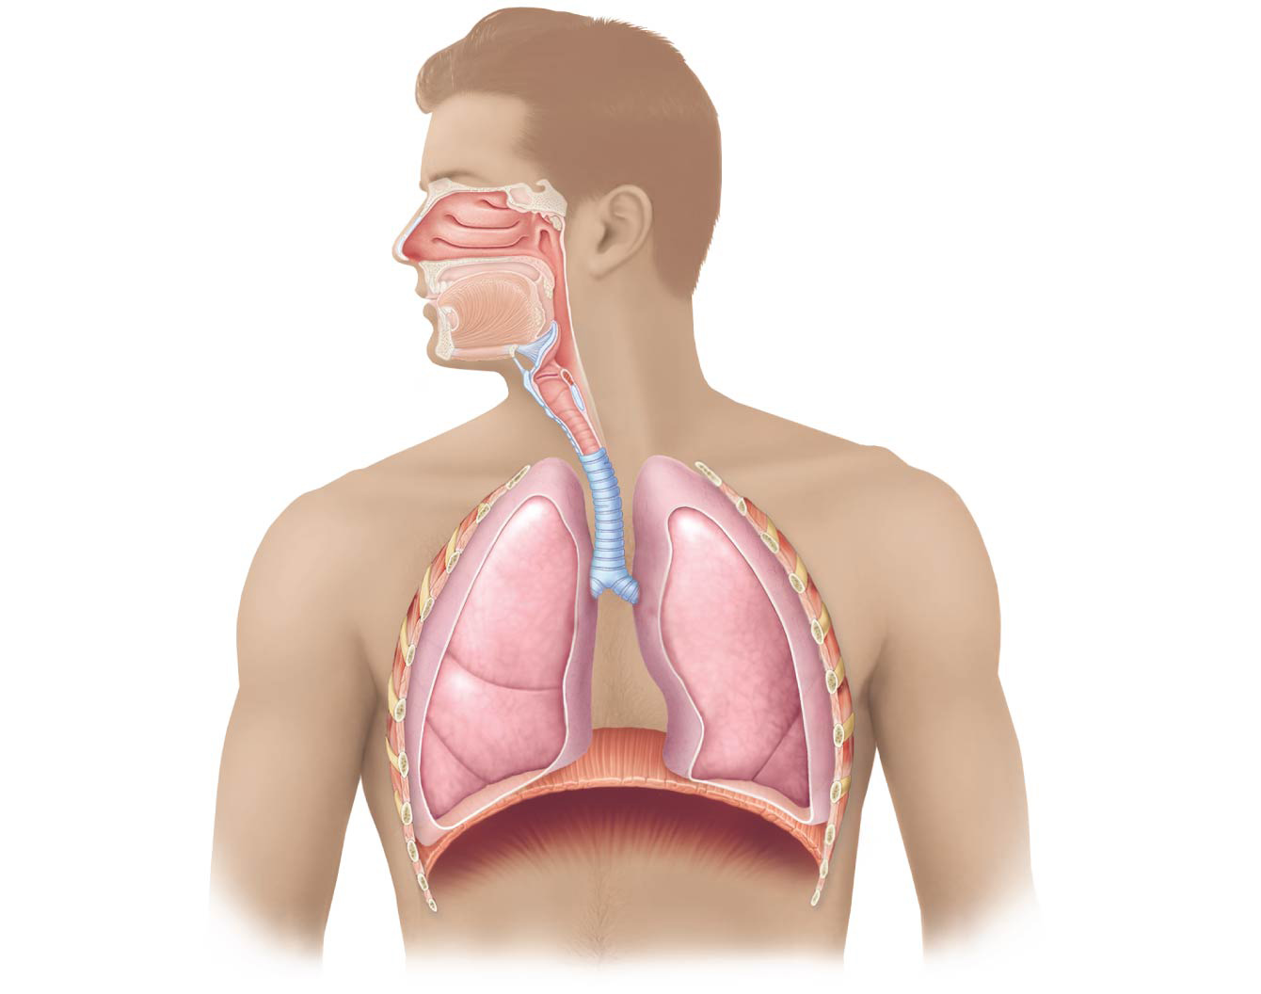
Nasal cavity
Oral cavity
Nostril
Pharynx
Larynx
Trachea
Left main
(primary)
bronchus
Right main
(primary)
bronchus
Left lung
Right lung
Diaphragm

Slide 4
Functions of the Respiratory System
Gas exchanges between the blood and external environment
Occur in the alveoli of the lungs
Passageways to the lungs purify, humidify, and warm the incoming air

Slide 5
The Nose
The only externally visible part of the respiratory system
Air enters the nose through the external nostrils (nares)
Interior of the nose consists of a nasal cavity divided by a nasal septum
Remember that if any area is open to the outside (even if it’s inside), it is lined with mucous membranes (wet/moist membranes)

Slide 6
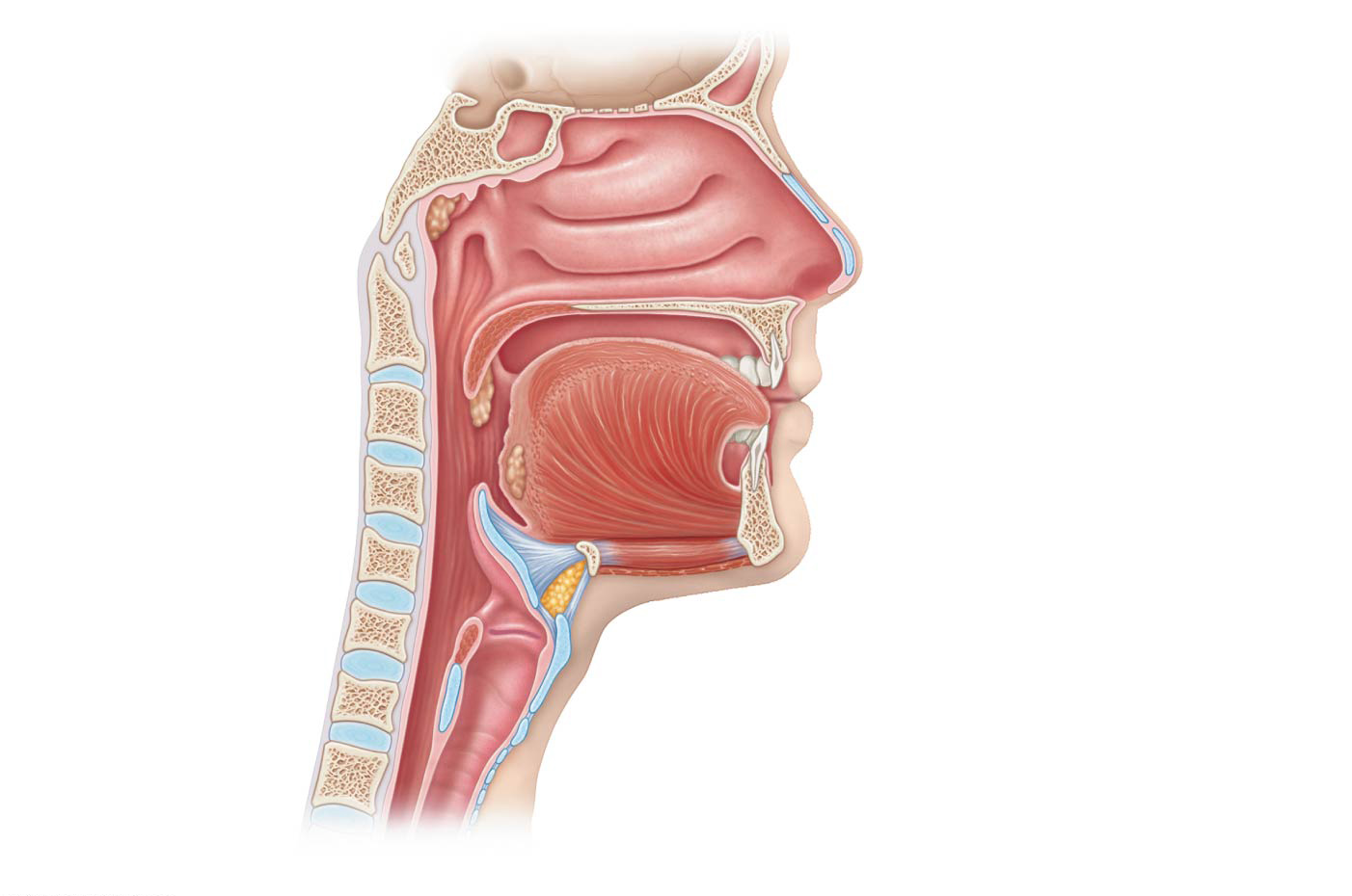
Cribriform plate
of ethmoid bone
Sphenoidal sinus
Frontal sinus
Posterior nasal
aperture
Nasal cavity
Nasal conchae (superior,
middle and inferior)
Nasopharynx
Pharyngeal tonsil
Nasal meatuses (superior,
middle, and inferior)
Opening of
pharyngotympanic
tube
Nasal vestibule
Nostril
Uvula
Hard palate
Oropharynx
Soft palate
Palatine tonsil
Tongue
Lingual tonsil
Larynx
Hyoid bone
Laryngopharynx
Epiglottis
Esophagus
Thyroid cartilage
Trachea
Vocal fold
Cricoid cartilage
(b)
Detailed anatomy of the upper respiratory tract

Slide 7
The Nose
Olfactory receptors are located in the mucosa on the superior surface
The rest of the cavity is lined with respiratory mucosa, which:
Moistens air
Traps incoming foreign particles

Slide 8
The Nose
Lateral walls have projections called conchae
Increase surface area
Increase air turbulence within the nasal cavity
The nasal cavity is separated from the oral cavity by the palate
Anterior hard palate (bone)
Posterior soft palate (unsupported)

Slide 9
Paranasal Sinuses
Cavities within bones surrounding the nasal cavity are called sinuses
Sinuses are located in the following bones:
Frontal
Sphenoid
Ethmoid
Maxillary

Slide 10
Cribriform plate
of ethmoid bone
Sphenoidal sinus
Frontal sinus
Posterior nasal
aperture
Nasal cavity
Nasal conchae (superior,
middle and inferior)
Nasopharynx
Pharyngeal tonsil
Nasal meatuses (superior,
middle, and inferior)
Opening of
pharyngotympanic
tube
Nasal vestibule
Nostril
Uvula
Hard palate
Oropharynx
Soft palate
Palatine tonsil
Tongue
Lingual tonsil
Larynx
Hyoid bone
Laryngopharynx
Epiglottis
Esophagus
Thyroid cartilage
Trachea
Vocal fold
Cricoid cartilage

Slide 11
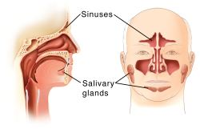
Paranasal Sinuses
Functions of the sinuses:
Lighten the skull
Act as resonance chambers for speech
Produce mucus that drains into the nasal cavity

Slide 12
Pharynx (Throat)
Muscular passage from nasal cavity to larynx
Three regions of the pharynx:
Nasopharynx—superior region behind nasal cavity
Oropharynx—middle region behind mouth
Laryngopharynx—inferior region attached to larynx
The oropharynx and laryngopharynx are common passageways for air and food

Slide 13
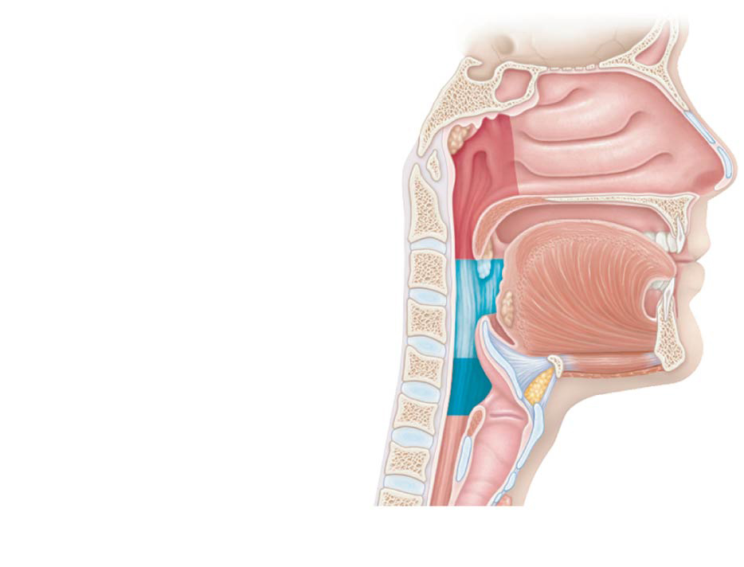
Pharynx
Nasopharynx
Oropharynx
Laryngopharynx
(a)
Regions of the pharynx

Slide 14
Pharynx (Throat)
Pharyngotympanic tubes open into the nasopharynx
Tonsils of the pharynx
Pharyngeal tonsil (adenoid) is located in the nasopharynx
Palatine tonsils are located in the oropharynx
Lingual tonsils are found at the base of the tongue

Slide 15
Cribriform plate
of ethmoid bone
Sphenoidal sinus
Frontal sinus
Posterior nasal
aperture
Nasal cavity
Nasal conchae (superior,
middle and inferior)
Nasopharynx
Pharyngeal tonsil
Nasal meatuses (superior,
middle, and inferior)
Opening of
pharyngotympanic
tube
Nasal vestibule
Nostril
Uvula
Hard palate
Oropharynx
Soft palate
Palatine tonsil
Tongue
Lingual tonsil
Larynx
Hyoid bone
Laryngopharynx
Epiglottis
Esophagus
Thyroid cartilage
Trachea
Vocal fold
Cricoid cartilage
(b)
Detailed anatomy of the upper respiratory tract

Slide 16
Larynx (Voice Box)
Routes air and food into proper channels
Plays a role in speech
Made of eight rigid hyaline cartilages and a spoon-shaped flap of elastic cartilage (epiglottis)
https://www.youtube.com/watch?v=LqdFL0u2HLY
https://www.youtube.com/watch?v=Tsh-0VvAGQA
https://www.youtube.com/watch?v=C7CpkEszksI

Slide 17
Larynx (Voice Box)
Thyroid cartilage
Largest of the hyaline cartilages
Protrudes anteriorly (Adam’s apple)
Epiglottis
Protects the superior opening of the larynx
Routes food to the posteriorly situated esophagus and routes air toward the trachea
When swallowing, the epiglottis rises and forms a lid over the opening of the larynx

Slide 18
Larynx (Voice Box)
Vocal folds (true vocal cords)
Vibrate with expelled air
The glottis consists of the vocal cords and the slitlike pathway (opening)

Slide 19
Figure 13.2b Basic anatomy of the upper respiratory tract, sagittal section.
Cribriform plate
of ethmoid bone
Sphenoidal sinus
Frontal sinus
Posterior nasal
aperture
Nasal cavity
Nasal conchae (superior,
middle and inferior)
Nasopharynx
Pharyngeal tonsil
Nasal meatuses (superior,
middle, and inferior)
Opening of
pharyngotympanic
tube
Nasal vestibule
Nostril
Uvula
Hard palate
Oropharynx
Soft palate
Palatine tonsil
Tongue
Lingual tonsil
Larynx
Hyoid bone
Laryngopharynx
Epiglottis
Esophagus
Thyroid cartilage
Trachea
Vocal fold
Cricoid cartilage
(b)
Detailed anatomy of the upper respiratory tract

Slide 20
Trachea (Windpipe)
4-inch-long tube that connects larynx with bronchi
Walls are reinforced with C-shaped hyaline cartilage, which keeps the trachea open (patent)
Lined with ciliated mucosa
Cilia beat continuously in the opposite direction of incoming air
Expel mucus loaded with dust and other debris away from lungs

Slide 21
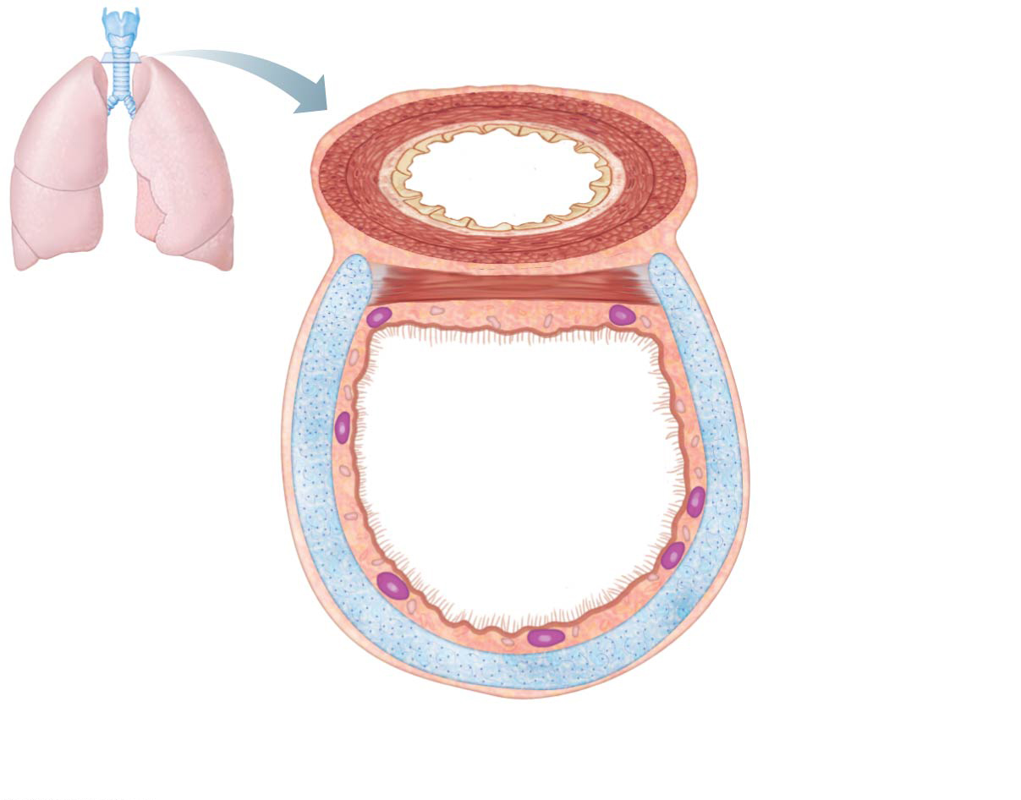
Figure 13.3a Structural relationship of the trachea and esophagus.
Posterior
Mucosa
Esophagus
Submucosa
Trachealis
muscle
Seromucous
gland in
submucosa
Lumen of
trachea
Hyaline
cartilage
Adventitia
Anterior
(a)

Slide 22
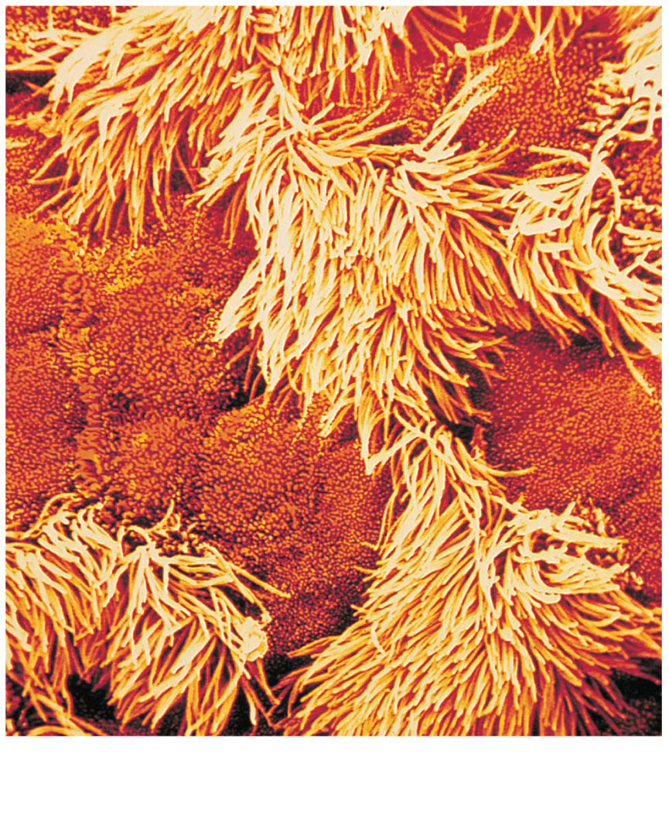
Figure 13.3b Structural relationship of the trachea and esophagus.
(b)

Slide 23
Main (Primary) Bronchi
Formed by division of the trachea
Each bronchus enters the lung at the hilum (medial depression)
Right bronchus is wider, shorter, and straighter than left
Bronchi subdivide into smaller and smaller branches

Slide 24
Figure 13.1 The major respiratory organs shown in relation to surrounding structures.
Nasal cavity
Oral cavity
Nostril
Pharynx
Larynx
Trachea
Left main
(primary)
bronchus
Right main
(primary)
bronchus
Left lung
Right lung
Diaphragm

Slide 25
Lungs
Occupy most of the thoracic cavity
Heart occupies central portion called mediastinum
Apex is near the clavicle (superior portion)
Base rests on the diaphragm (inferior portion)
Each lung is divided into lobes by fissures
Left lung—two lobes
Right lung—three lobes

Slide 26
Coverings of the Lungs
Serosa covers the outer surface of the lungs
Pulmonary (visceral) pleura covers the lung surface
Parietal pleura lines the walls of the thoracic cavity
Pleural fluid fills the area between layers to allow gliding and decrease friction during breathing
Pleural space (between the layers) is more of a potential space

Slide 27
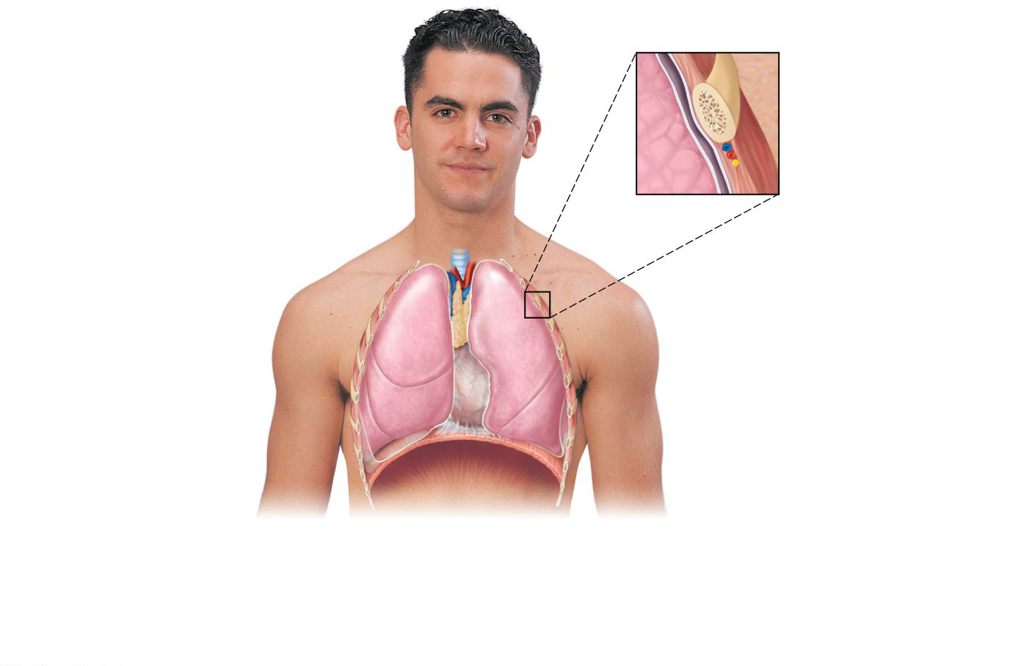
Figure 13.4a Anatomical relationships of organs in the thoracic cavity.
Intercostal muscle
Rib
Parietal pleura
Trachea
Lung
Pleural cavity
Visceral pleura
Thymus
Apex of lung
Right superior lobe
Left superior lobe
Horizontal fissure
Oblique fissure
Right middle lobe
Oblique fissure
Left inferior lobe
Right inferior lobe
Heart
(in pericardial cavity
of mediastinum)
Diaphragm
Base of lung
(a)
Anterior view. The lungs flank mediastinal structures laterally.

Slide 28
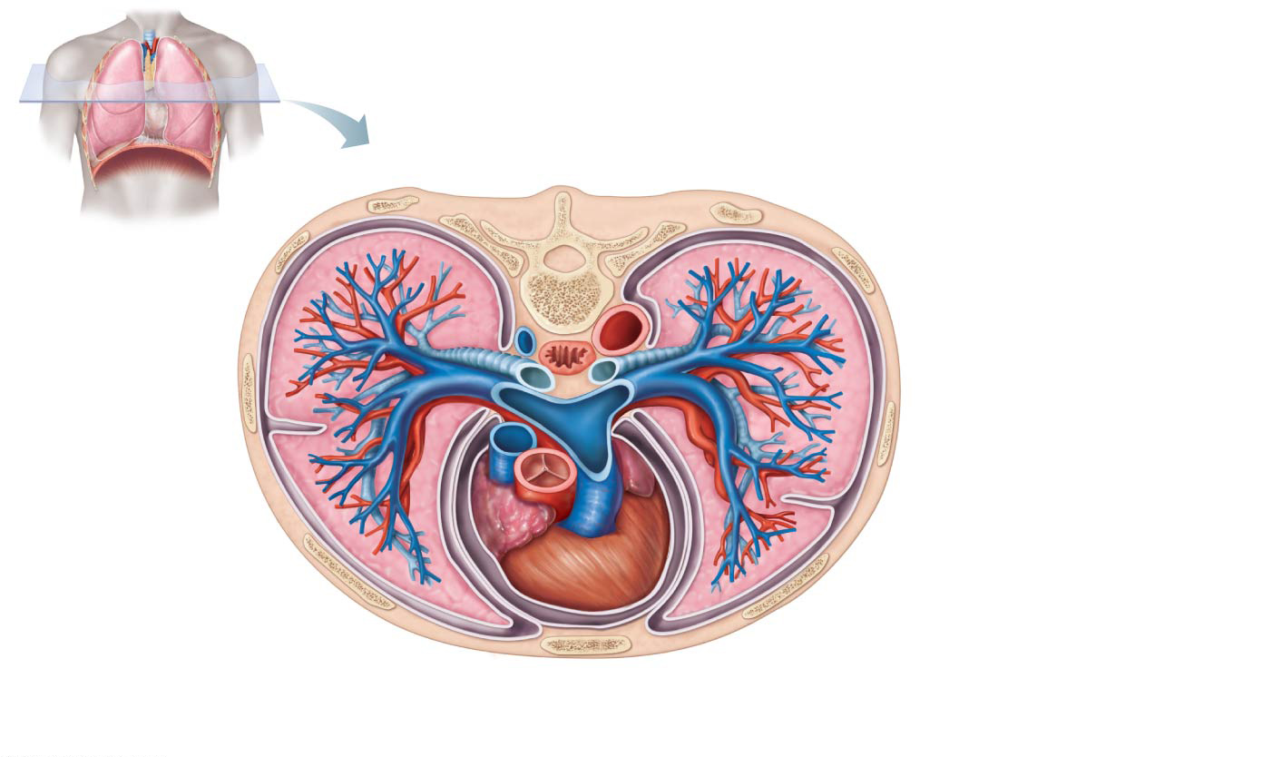
Figure 13.4b Anatomical relationships of organs in the thoracic cavity.
Posterior
Esophagus
(in posterior mediastinum)
Vertebra
Root of lung at hilum
Right lung
Left main bronchus
Left pulmonary artery
Parietal pleura
Left pulmonary vein
Visceral pleura
Pleural cavity
Left lung
Thoracic wall
Pulmonary trunk
Pericardial
membranes
Heart (in mediastinum)
Sternum
Anterior mediastinum
Anterior
(b)
Transverse section through the thorax, viewed from above.

Slide 29
Bronchial (Respiratory) Tree Divisions
All but the smallest of these passageways have reinforcing cartilage in their walls
Conduits to and from the respiratory zone
Primary bronchi
Secondary bronchi
Tertiary bronchi
Bronchioles
Terminal bronchioles

Slide 30
Respiratory Zone Structures
Respiratory bronchioles
Alveolar ducts
Alveolar sacs
Alveoli (air sacs)

Slide 31
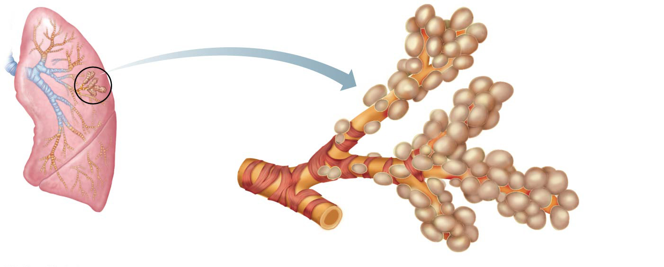
Figure 13.5a Respiratory zone structures.
Alveolar duct
Alveoli
Respiratory
bronchioles
Alveolar duct
Terminal
bronchiole
Alveolar
sac
(a)
Diagrammatic view of respiratory
bronchioles, alveolar ducts, and alveoli

Slide 32
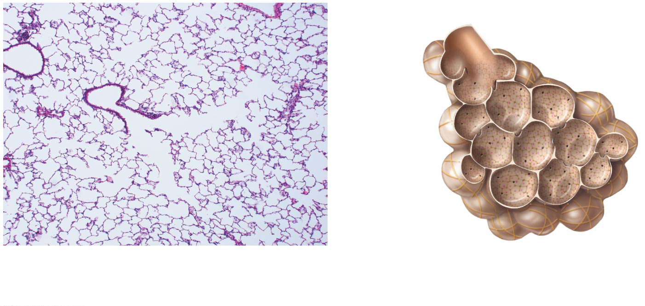
Figure 13.5b Respiratory zone structures.
Alveolar
duct
Alveolar
pores
Alveolus
(b)
Light micrograph of human lung tissue,
showing the final divisions of the
respiratory tree (120×)

Slide 33
The Respiratory Membrane
Thin squamous epithelial layer lines alveolar walls
Alveolar pores connect neighboring air sacs
Pulmonary capillaries cover external surfaces of alveoli
Respiratory membrane (air-blood barrier)
On one side of the membrane is air, and on the other side is blood flowing past
Formed by alveolar and capillary walls

Slide 34
The Respiratory Membrane
Gas crosses the respiratory membrane by diffusion
Oxygen enters the blood
Carbon dioxide enters the alveoli
Alveolar macrophages (“dust cells”) add protection by picking up bacteria, carbon particles, and other debris
Surfactant (a lipid molecule) coats gas-exposed alveolar surfaces

Slide 35
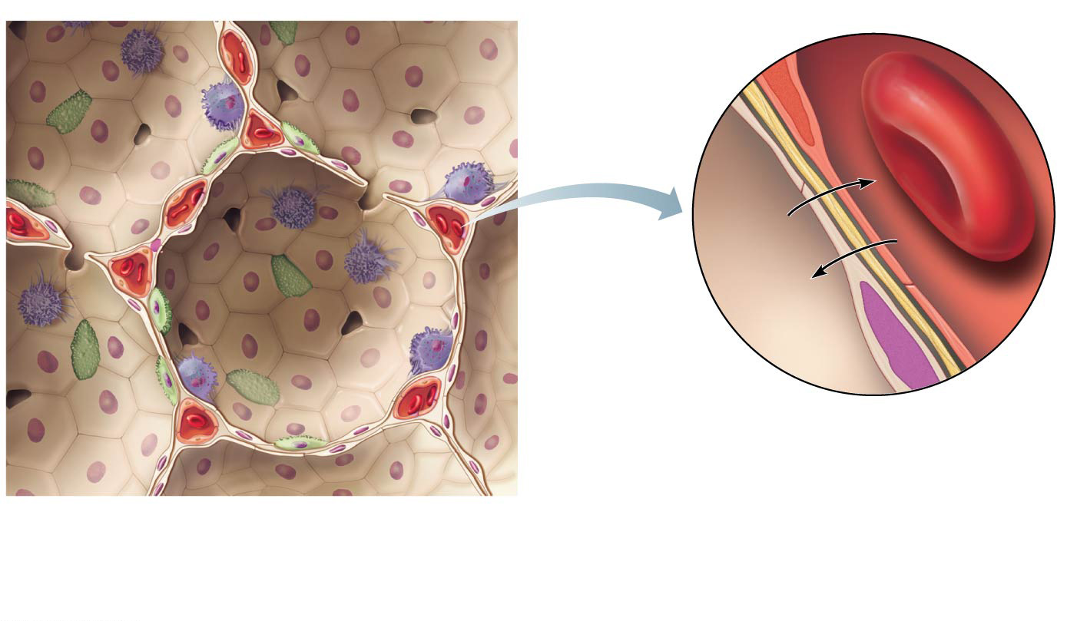
Figure 13.6 Anatomy of the respiratory membrane (air-blood barrier).
Red blood cell
Endothelial cell
nucleus
Capillary
Alveolar pores
Capillary
O₂
CO₂
Macrophage
Alveolus
Nucleus of
squamous
epithelial cell
Respiratory
membrane
Alveolar epithelium
Fused basement
membranes
Capillary endothelium
Alveoli (gas-
filled air
spaces)
Red blood
cell in
capillary
Surfactant-
secreting cell
Squamous
epithelial cell
of alveolar wall

Slide 36
Four Events of Respiration
Pulmonary ventilation—moving air into and out of the lungs (commonly called breathing)
External respiration—gas exchange between pulmonary blood and alveoli
Oxygen is loaded into the blood
Carbon dioxide is unloaded from the blood

Slide 37
Four Events of Respiration
Respiratory gas transport—transport of oxygen and carbon dioxide via the bloodstream
Internal respiration—gas exchange between blood and tissue cells in systemic capillaries

Slide 38
Mechanics of Breathing (Pulmonary Ventilation)
Completely mechanical process that depends on volume changes in the thoracic cavity
Volume changes lead to pressure changes, which lead to the flow of gases to equalize pressure

Slide 39
Mechanics of Breathing (Pulmonary Ventilation)
Two phases
Inspiration = inhalation
Flow of air into lungs
Expiration = exhalation
Air leaving lungs

Slide 40
Mechanics of Breathing (Pulmonary Ventilation)
Inspiration
Diaphragm and external intercostal muscles contract
The size of the thoracic cavity increases
External air is pulled into the lungs as a result of:
Increase in intrapulmonary volume
Decrease in gas pressure
Air is sucked into the lungs

Slide 41
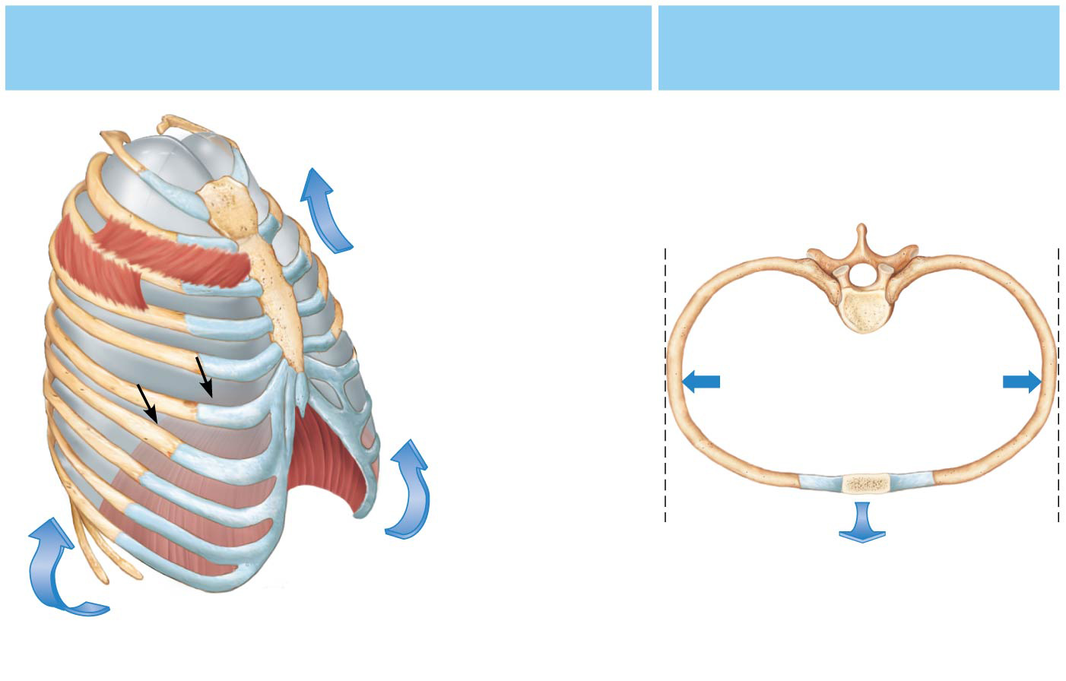
Figure 13.7a Rib cage and diaphragm positions during breathing.
Changes in anterior-posterior and
superior-inferior dimensions
Changes in lateral
dimensions
Ribs elevated
as external
intercostals
contract
External
intercostal
muscles
Full inspiration
(External
intercostals contract)
Diaphragm moves
inferiorly during
contraction
(a)
Inspiration: Air (gases) flows into the lungs

Slide 42
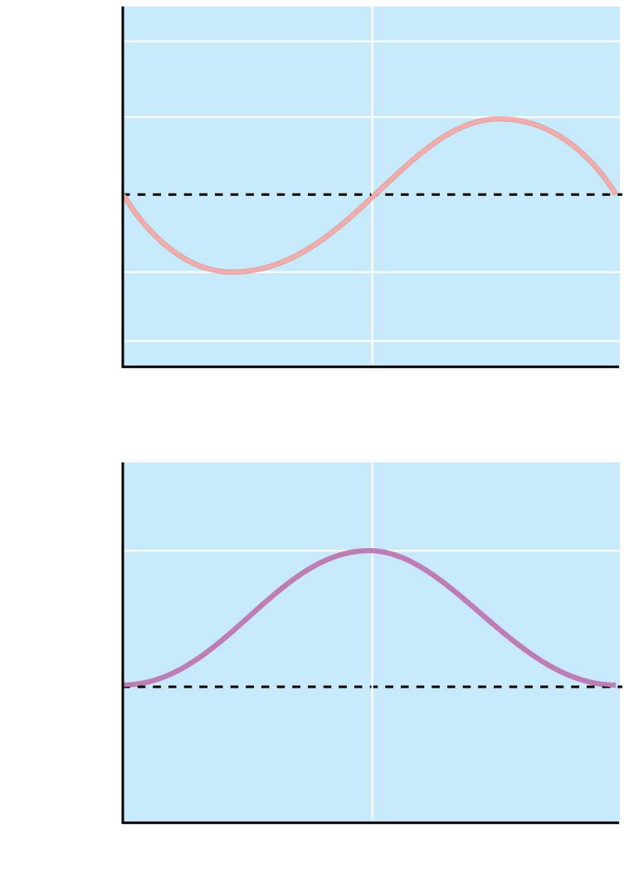
Figure 13.8 Changes in intrapulmonary pressure and air flow during inspiration and expiration.
Inspiration
Expiration
+2
Intrapulmonary
pressure
+1
Pressure relative
to atmospheric pressure
0
−1
−2
(a)
Volume of
breath
0.5
Volume (L)
0
−0.5
(b)

Slide 43
Mechanics of Breathing (Pulmonary Ventilation)
Expiration
Largely a passive process that depends on natural lung elasticity
As muscles relax, air is pushed out of the lungs as a result of:
Decrease in intrapulmonary volume
Increase in gas pressure
Forced expiration can occur mostly by contraction of internal intercostal muscles to depress the rib cage

Slide 45
Mechanics of Breathing (Pulmonary Ventilation)
Normal pressure within the pleural space is always negative (intrapleural pressure)
Differences in lung and pleural space pressures keep lungs from collapsing
Atelectasis is collapsed lung
Pneumothorax is the presence of air in the intrapleural space

Slide 46
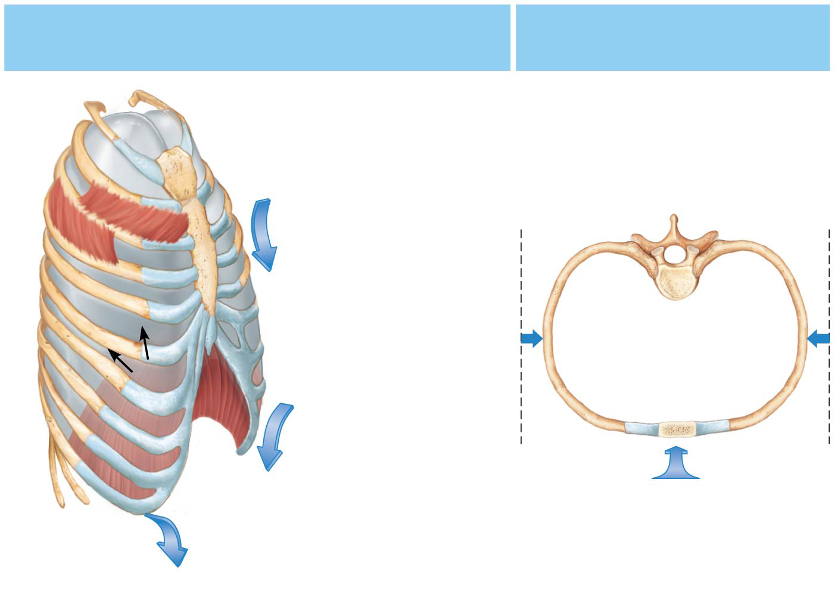
Figure 13.7b Rib cage and diaphragm positions during breathing.
Changes in anterior-posterior and
superior-inferior dimensions
Changes in lateral
dimensions
Ribs depressed
as external
intercostals relax
External
intercostal
muscles
Expiration
(External
intercostals relax)
Diaphragm moves
superiorly as
it relaxes
(b)
Expiration: Air (gases) flows out of the lungs

Slide 47
Inspiration
Expiration
+2
Intrapulmonary
pressure
+1
Pressure relative
to atmospheric pressure
0
−1
−2
(a)
Volume of
breath
0.5
Volume (L)
0
−0.5
(b)

Slide 48
Respiratory Volumes and Capacities
Normal breathing moves about 500 ml of air with each breath
This respiratory volume is tidal volume (TV)
Many factors affect respiratory capacity
A person’s size
Sex
Age
Physical condition

Slide 49
Respiratory Volumes and Capacities
Inspiratory reserve volume (IRV)
Amount of air that can be taken in forcibly over the tidal volume
Usually around 3,100 ml
Expiratory reserve volume (ERV)
Amount of air that can be forcibly exhaled after a tidal expiration
Approximately 1,200 ml

Slide 50
Respiratory Volumes and Capacities
Residual volume
Air remaining in lung after expiration
Allows gas exchange to go on continuously, even between breaths, and helps keep alveoli open (inflated)
About 1,200 ml

Slide 51
Respiratory Volumes and Capacities
Vital capacity
The total amount of exchangeable air
Vital capacity = TV + IRV + ERV
4,800 ml in men; 3,100 ml in women
Dead space volume
Air that remains in conducting zone and never reaches alveoli
About 150 ml

Slide 52
Respiratory Volumes and Capacities
Functional volume
Air that actually reaches the respiratory zone
Usually about 350 ml
Respiratory capacities are measured with a spirometer

Slide 53
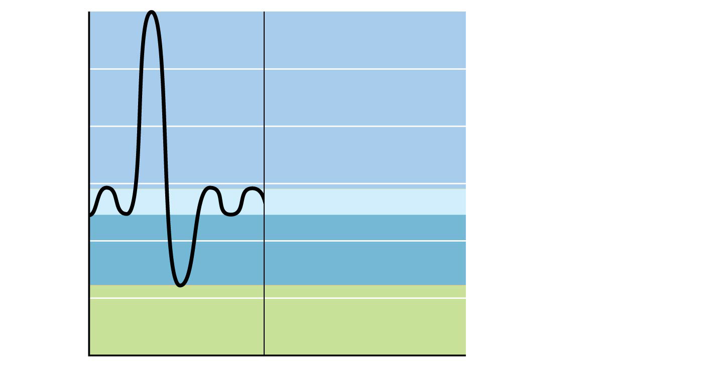
6,000
5,000
Inspiratory
reserve volume
3,100 ml
4,000
Vital
capacity
4,800 ml
Milliliters (ml)
3,000
Total lung
capacity
6,000 ml
Tidal volume 500 ml
Expiratory
reserve volume
1,200 ml
2,000
1,000
Residual volume
1,200 ml
0

Slide 54
Nonrespiratory Air (Gas) Movements
Can be caused by reflexes or voluntary actions
Examples:
Cough and sneeze—clears lungs of debris
Crying—emotionally induced mechanism
Laughing—similar to crying
Hiccup—sudden inspirations
Yawn—very deep inspiration
https://www.youtube.com/watch?v=h53Q0tslR9Y

Slide 55
